Slide 1
ONLINE STORE ANALYTIC

Slide 2
HELLO!
I am Bayu Nugroho
I am very happy standing here to give a presentation to you.
You can find me at bayunugrozzz@gmail.com

Slide 3
Information is the oil of the 21st century, and analytics is the combustion engine.
-peter sondergaard-

Slide 4
ABOUT DATASETS AND ANALYTIC TECHNIQUES
This datasets wich contains all the transactions occuring between 01/12/2010 and 09/12/2011 for UK-based and registered non-store online retail. The company mainly sells unique all-occasion gifts and many customers of the company are wholesalers.
In this analysis, there are several data analysis techniques such as exponential smothing techniques on time-series data, RFM models and K-MEANS clustering for customer segmentation.
The tool used in this analysis is Jupyter Lab with Python programming language. Libraries used in the analysis include Pandas, Numpy, Matplotlib, Seaborn, Scikit-Learn and several other libraries.

Slide 5
OUR ANALYTICS PROCESS
DATA OVERVIEW & S.W.O.T ANALYSIS
MARKET EXPANSION
RFM MODEL & K-MEANS CLUSTERING

Slide 6
DATA OVERVIEW
1
What knowledge can be taken from existing data?

Slide 7
£8.998.808-5.16%
Whoaaaaa! This is the sales revenue in 2011

Slide 8
£ 19.287.250
6300+ Costumers
5000+ Products
The company sales revenue of the last 2 years
Number of Customers
Number of Products

Slide 9
1.033.033
92.6%
Number of Transactions
Transactions take place in the UK

Slide 10
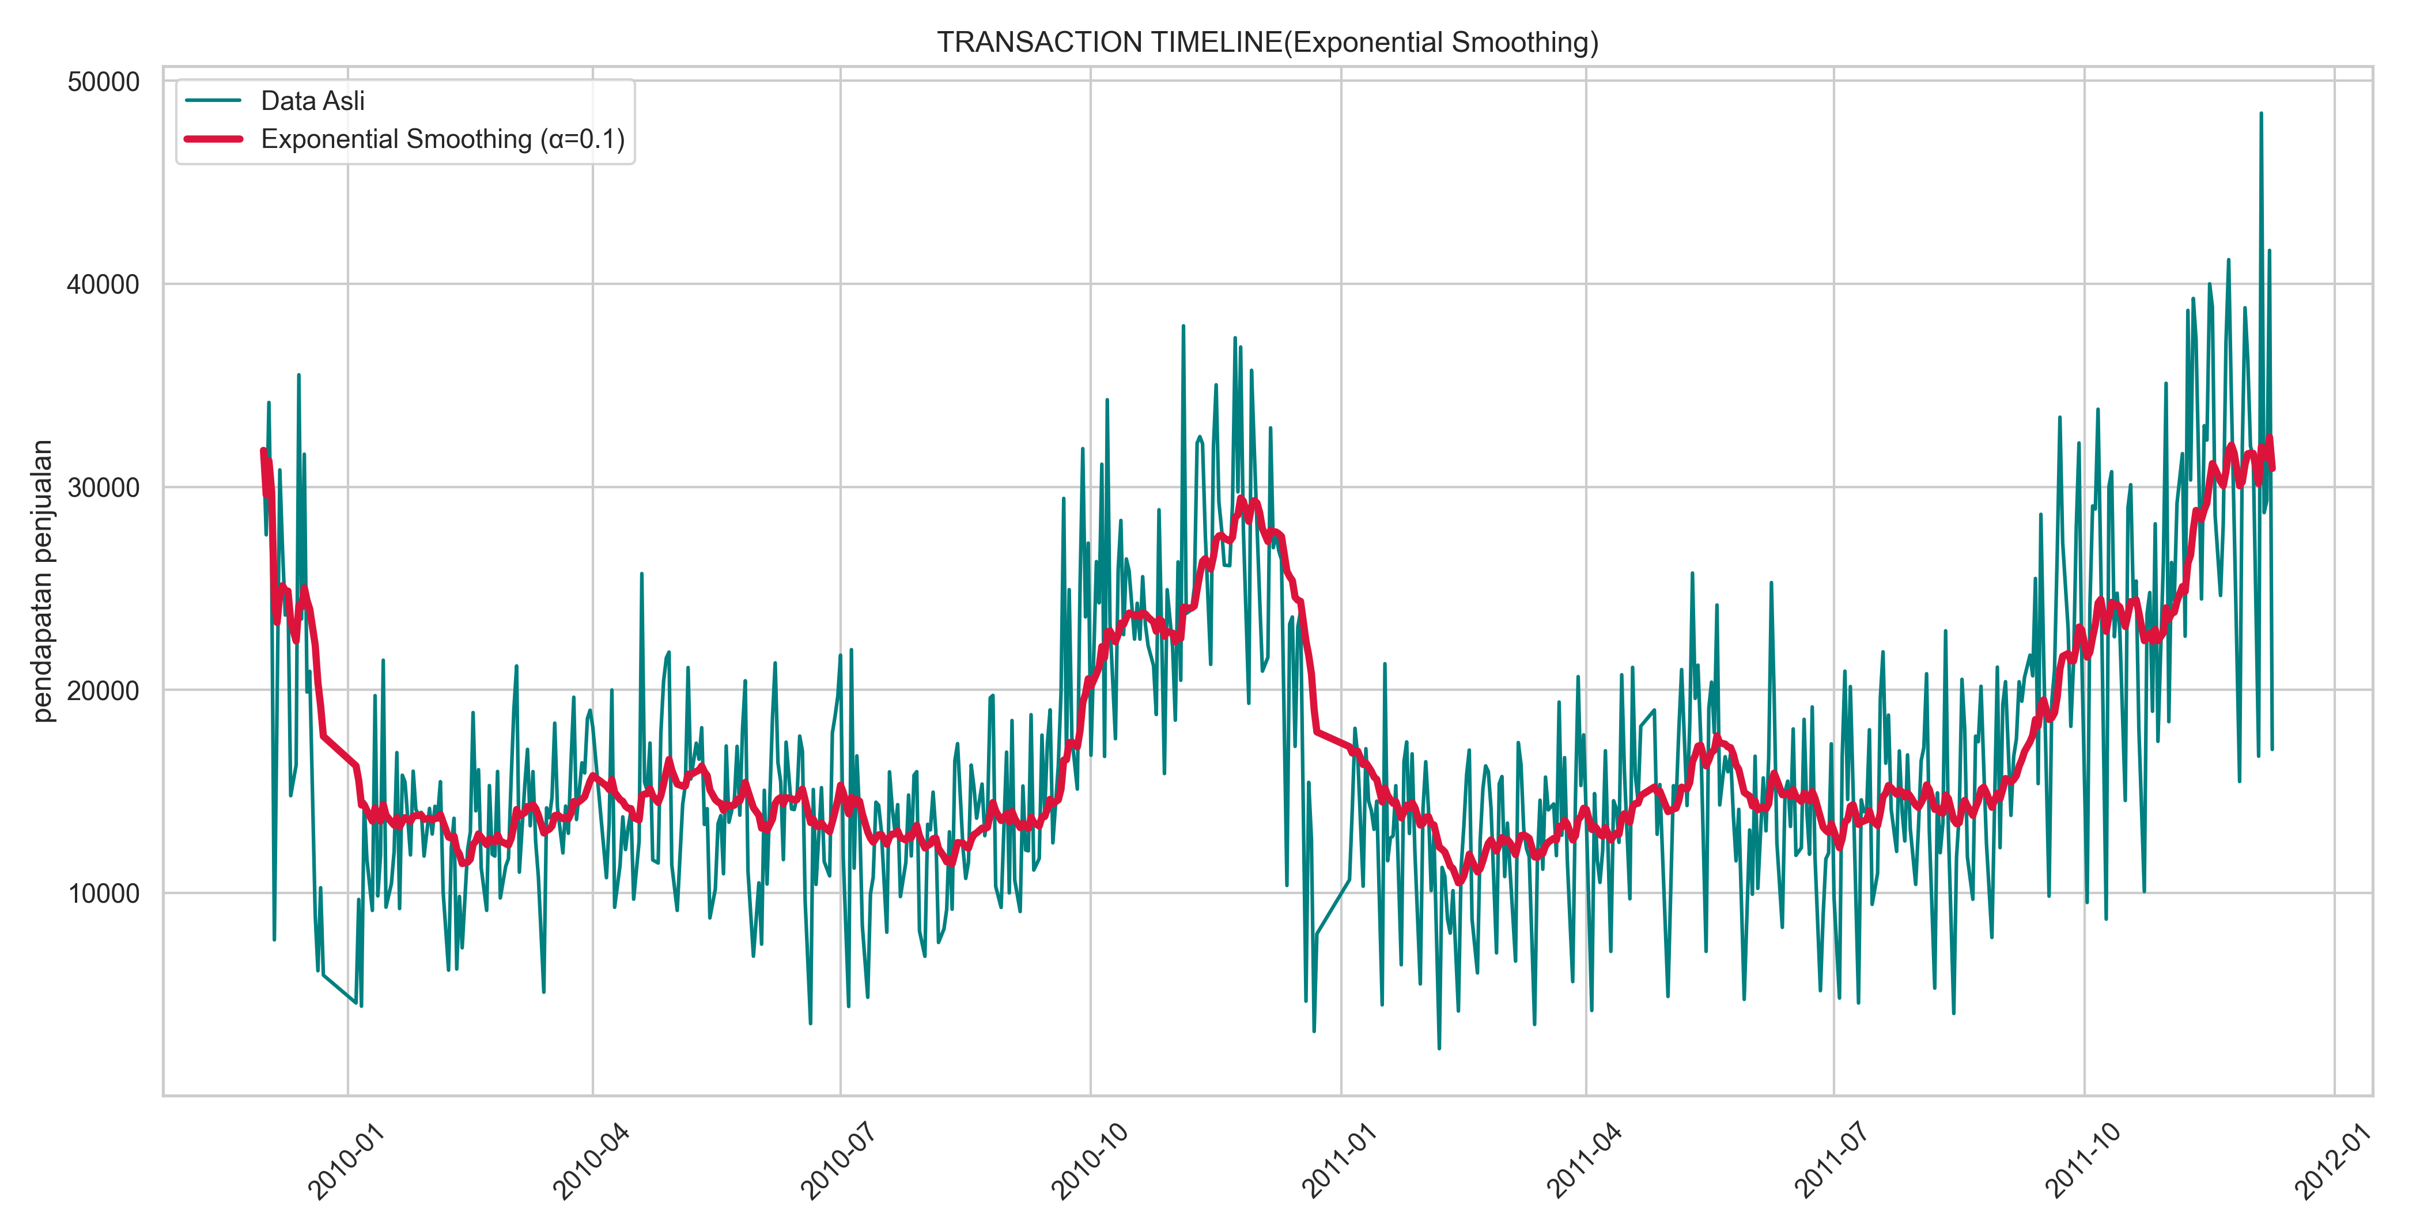
Transaction Patterns That Occurred in the Last 2 Years

Slide 11
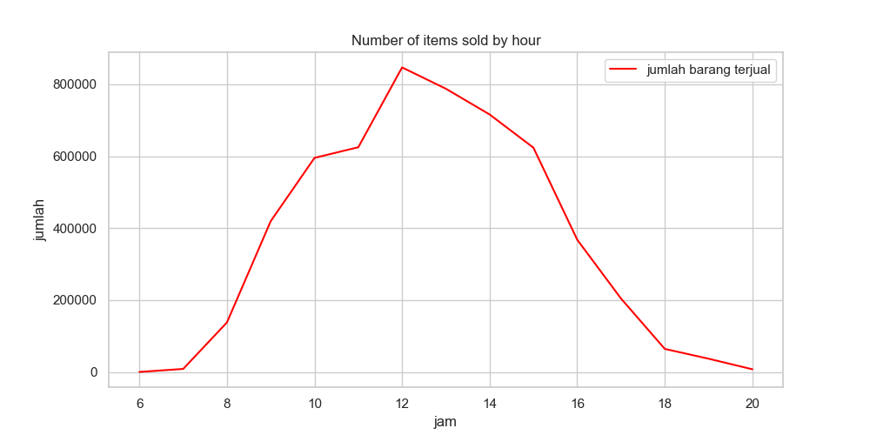
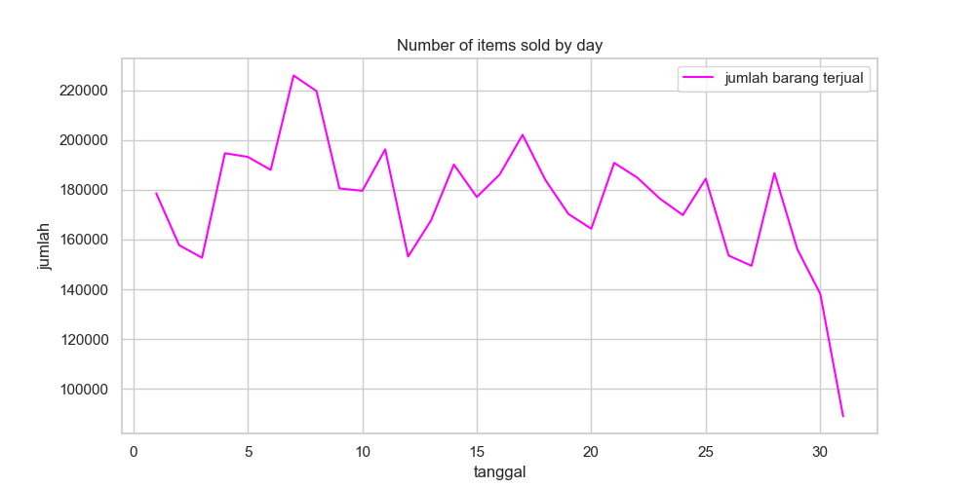
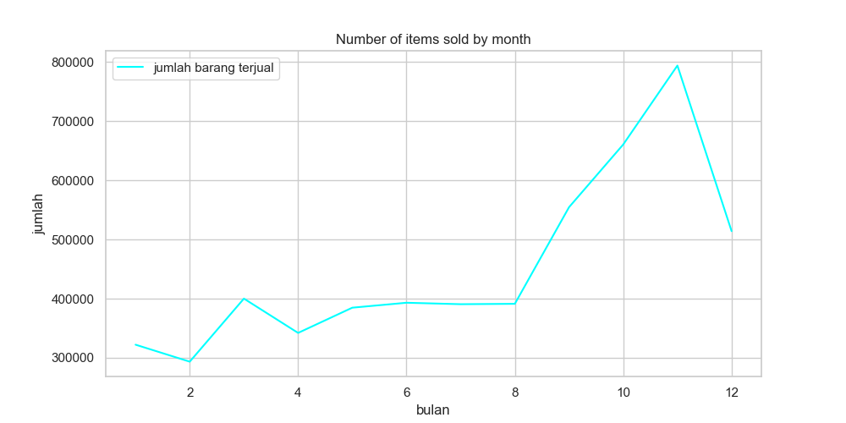
Transaction Pattern According to the Time of Transaction

Slide 12
S.W.O.T ANALYSIS BASED ON DATA
STRENGTHS
Blue ocean business
Goods cencel by customers are very few (below 1 percent)
WEAKNESSES
No customer segmentation
Market Penetration Only Focuses on 1 Region
S
W
Customers outside the UK tend to buy more expensive items
Strong customer base in the UK
Many Customers as Resellers
OPPORTUNITIES
Sales revenue down
Customer retention
THREATS
O
T

Slide 13
MARKET EXPANSION
2
Market Expansion ?? Is it necessary to ??!!

Slide 14
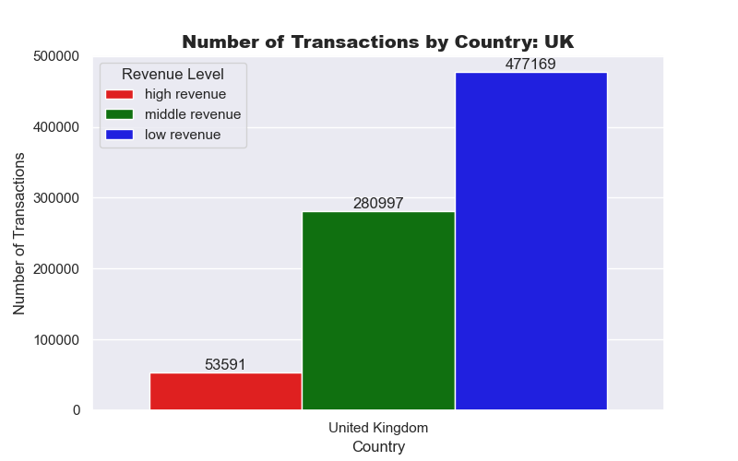
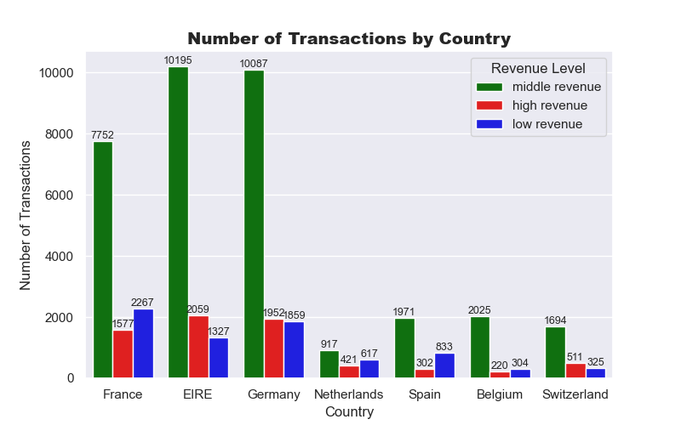
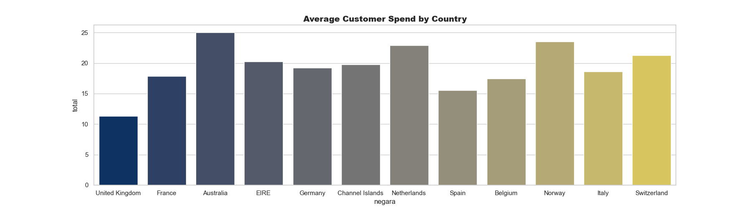

Slide 15
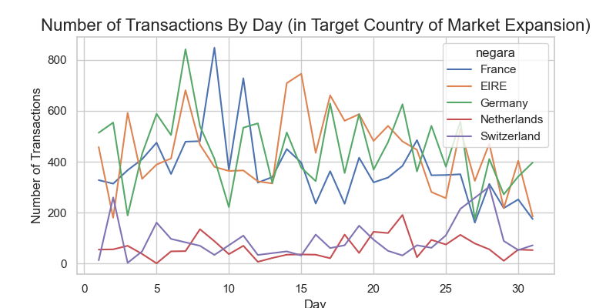
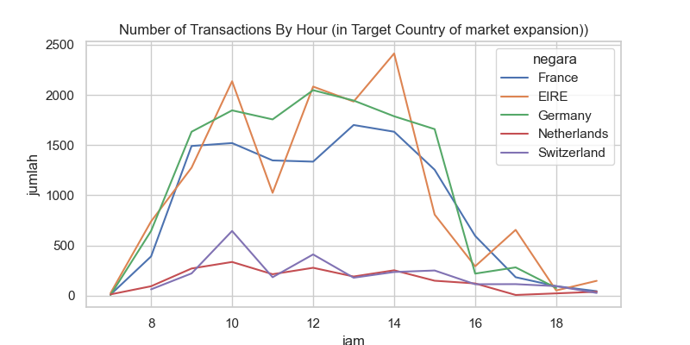
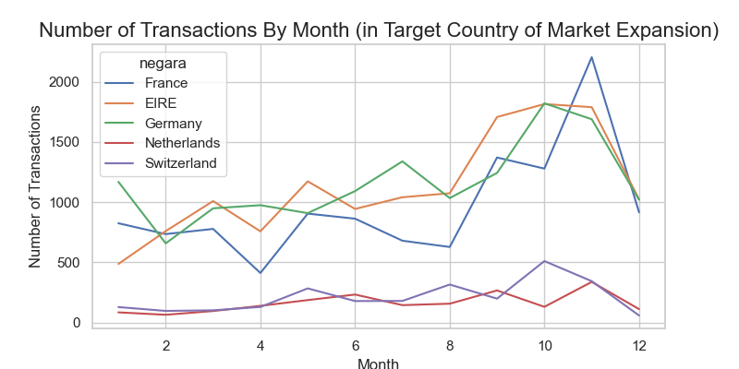
Transaction Patterns in Expansion Target Countries

Slide 16
RFM MODELS & K-MEANS CLUSTERING
3
It's time for modeling!!!

Slide 17

RFM MODEL
RECENCY
FREQUENCY
MONETERY
Benefit:
Customer Segmentation
Personalization and targeting
Customer retention
Marketing optimization

Slide 18
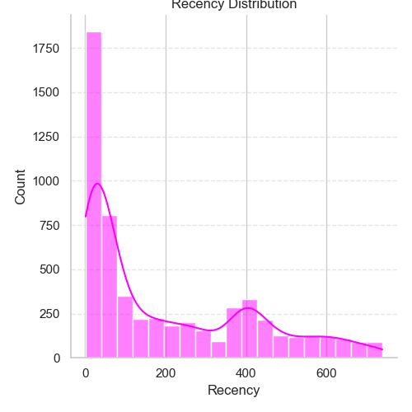
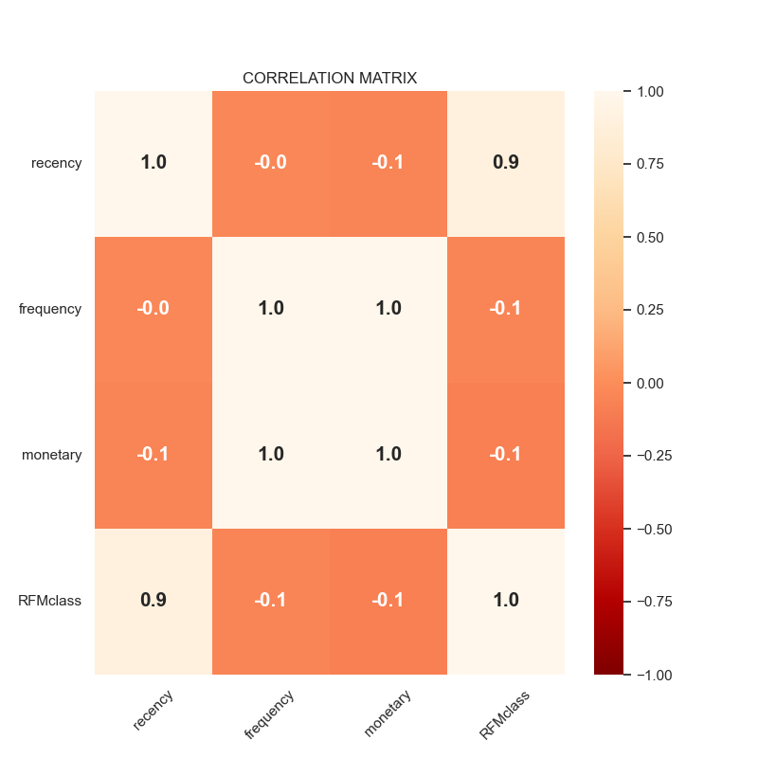
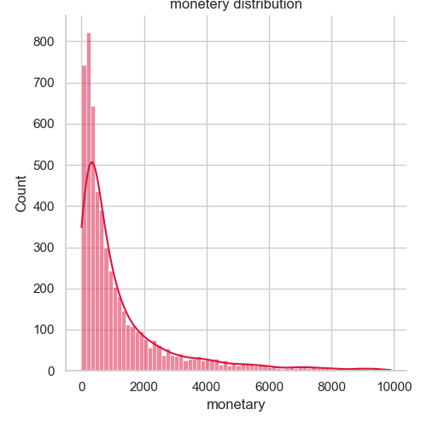
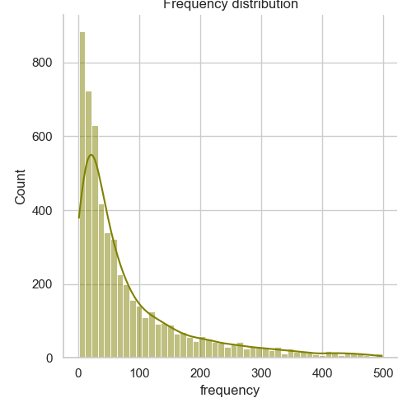
Statistical Visualization (RFM)

Slide 19
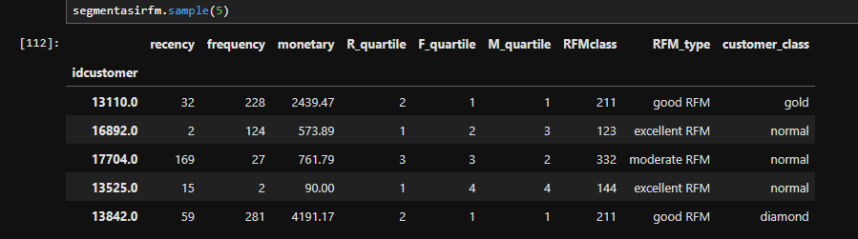
RFM Table Results Processed in Jupyter Lab

Slide 20
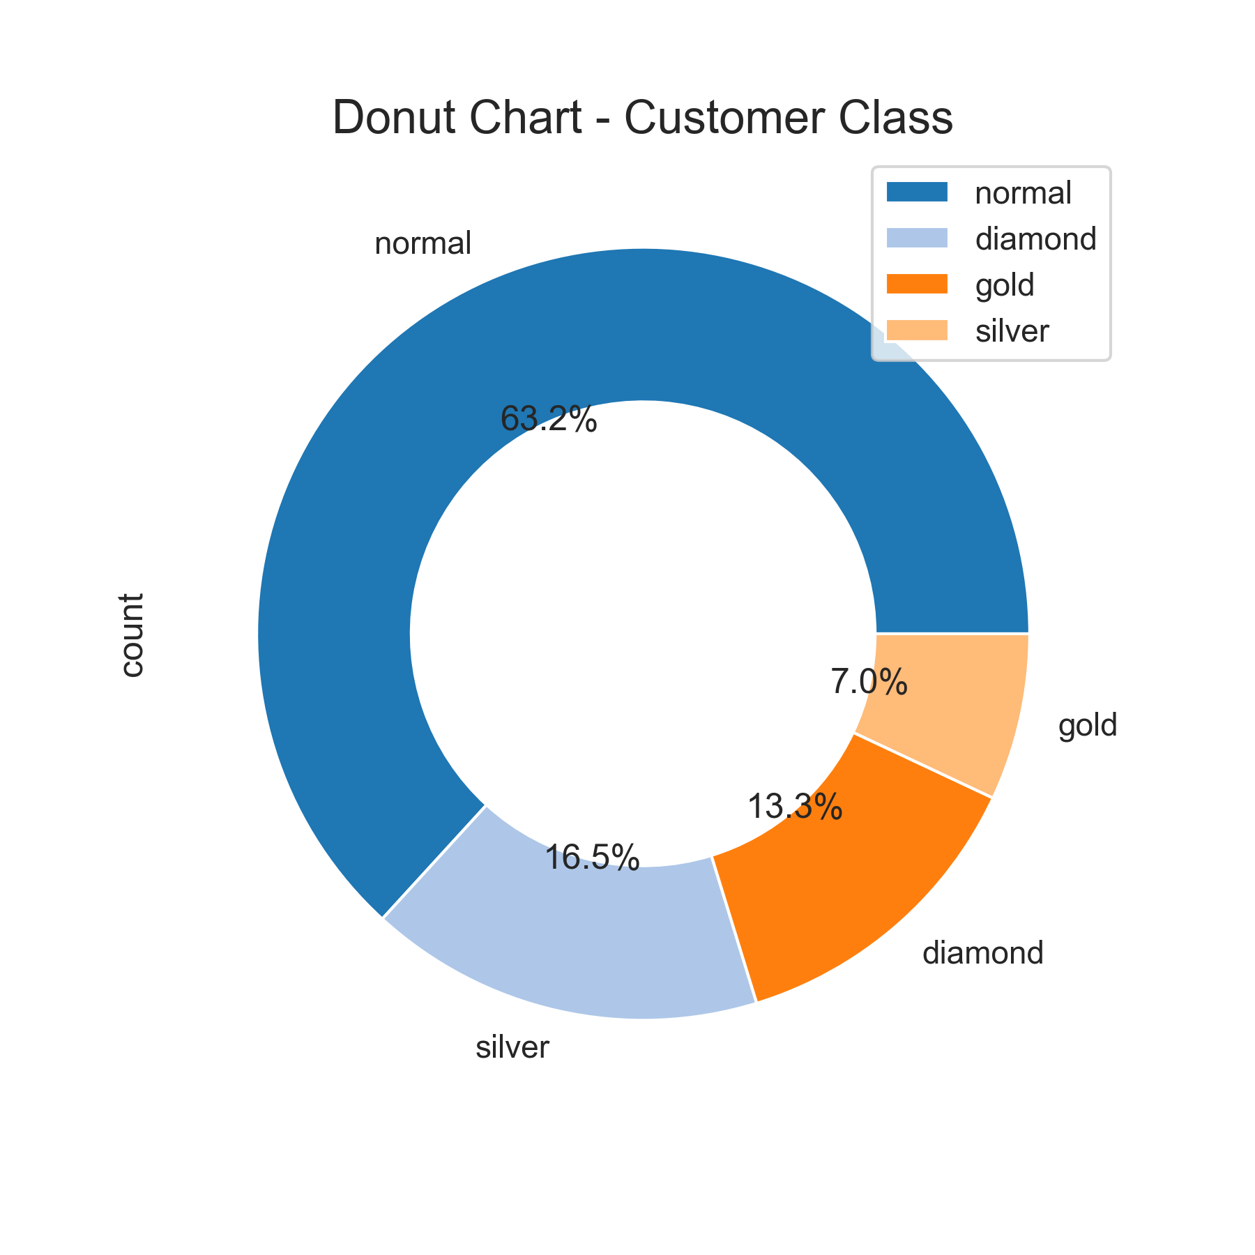
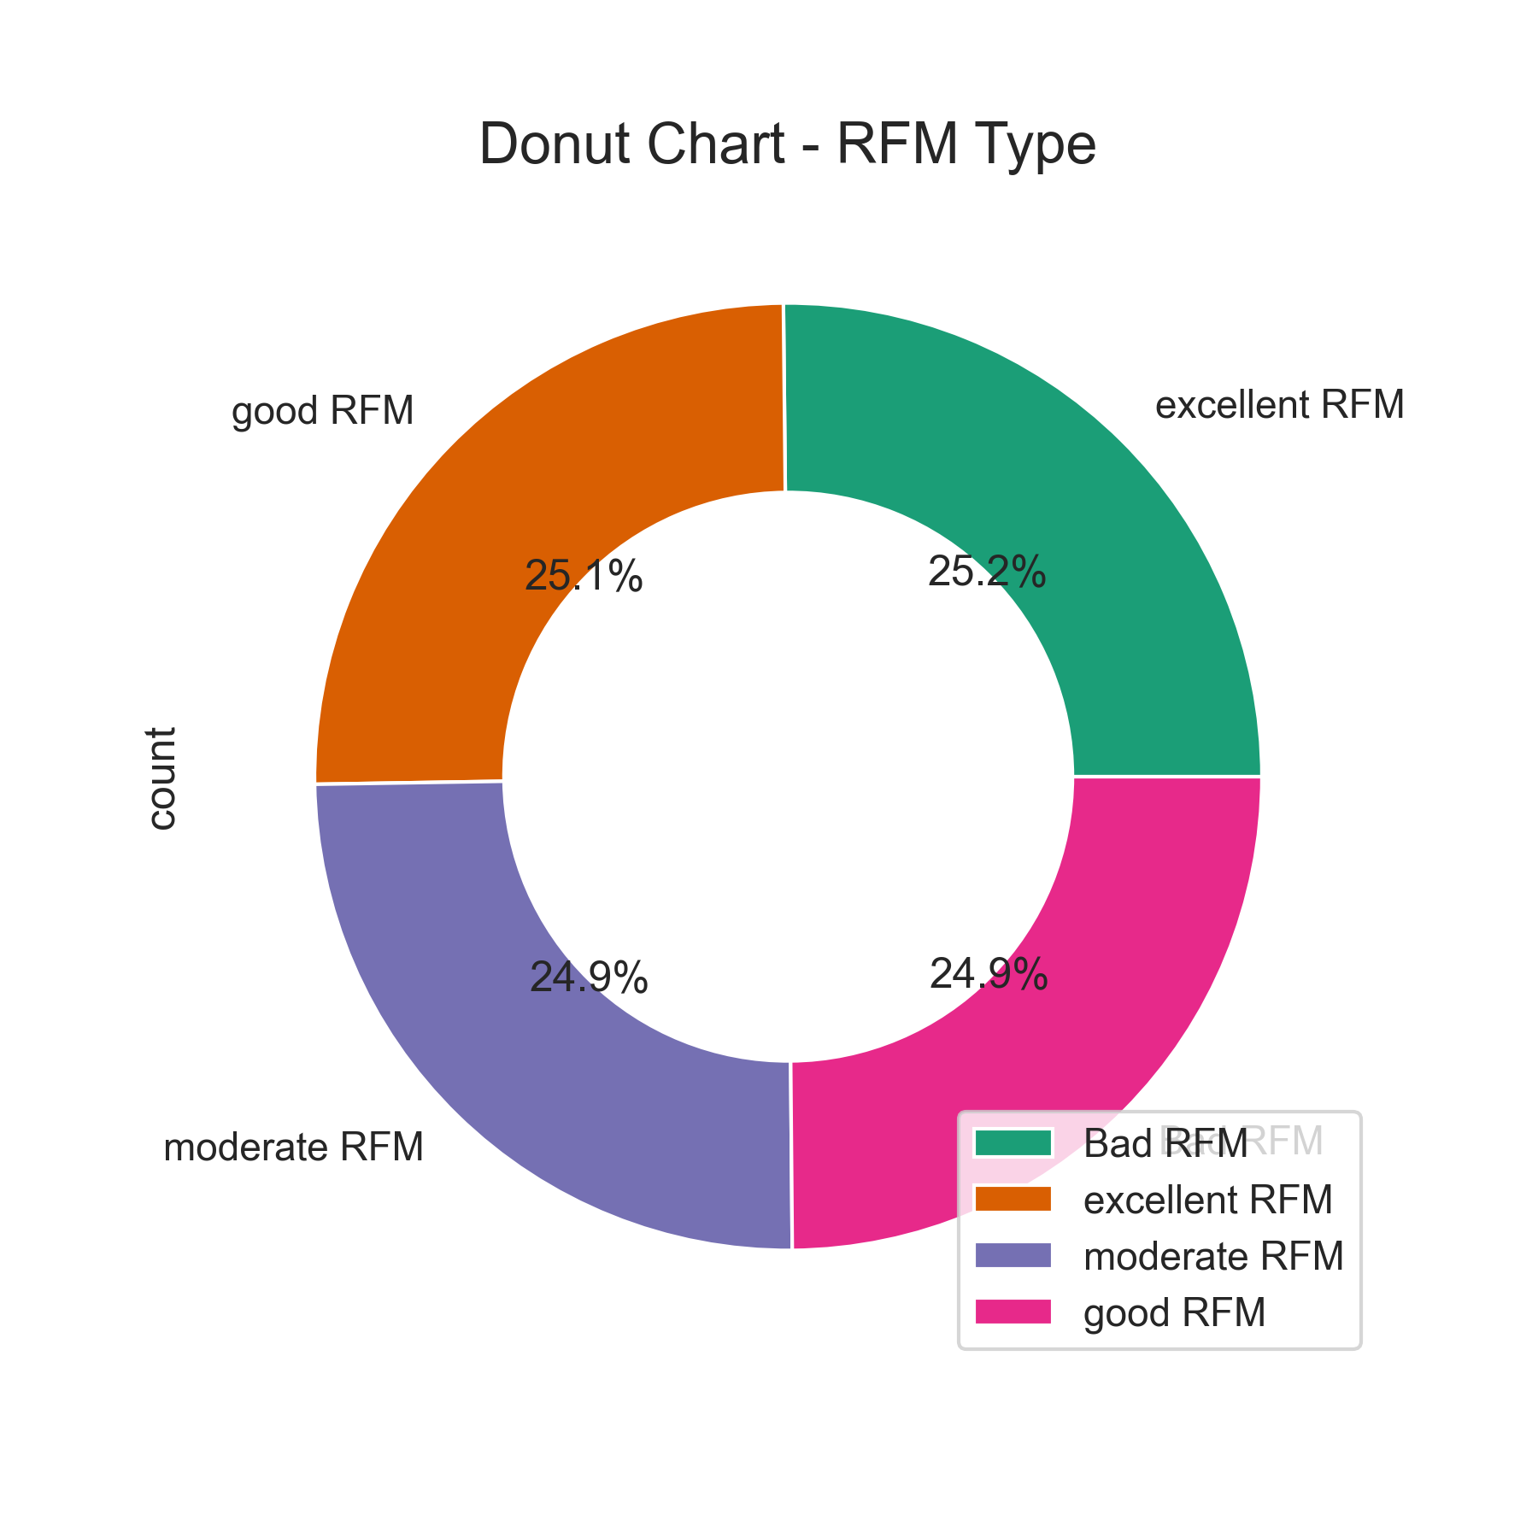
proportion of Customer class and RFM Type

Slide 21
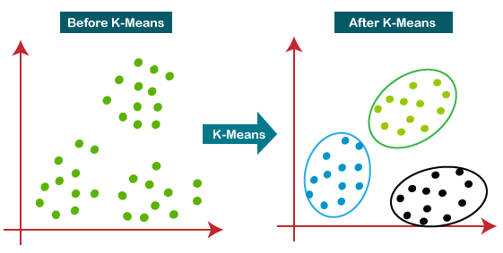
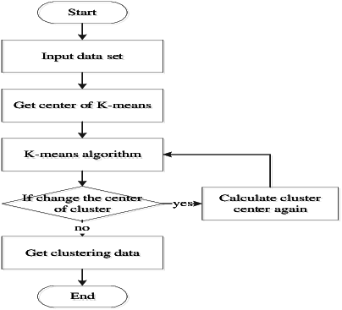
K-MEANS CLUSTERING
WHAT IS KMEANS CLUSTERING?
HOW TO DO IT?

Slide 22
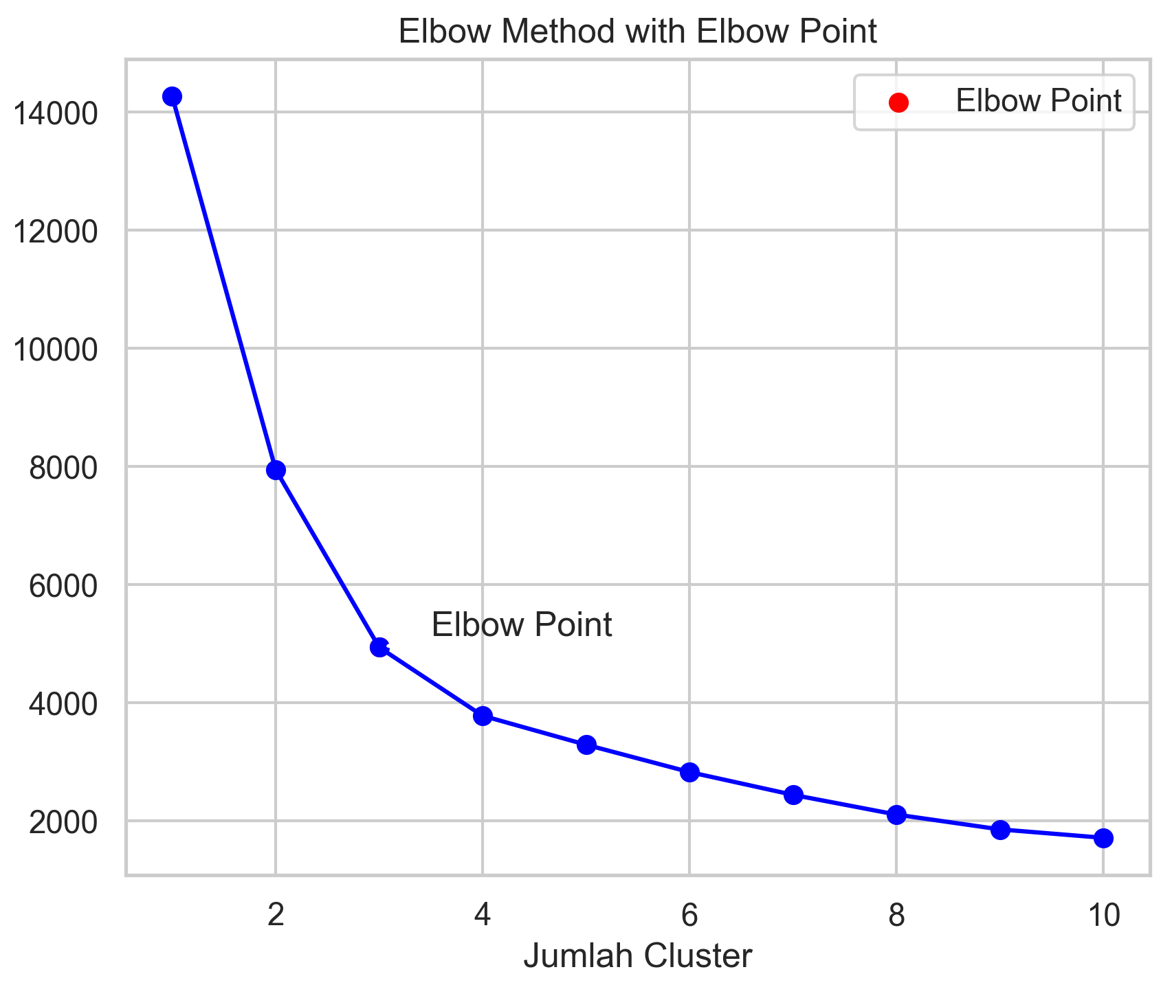
HOW TO DETERMINE THE NUMBER OF CLUSTERS IN KMEANS?

Slide 23
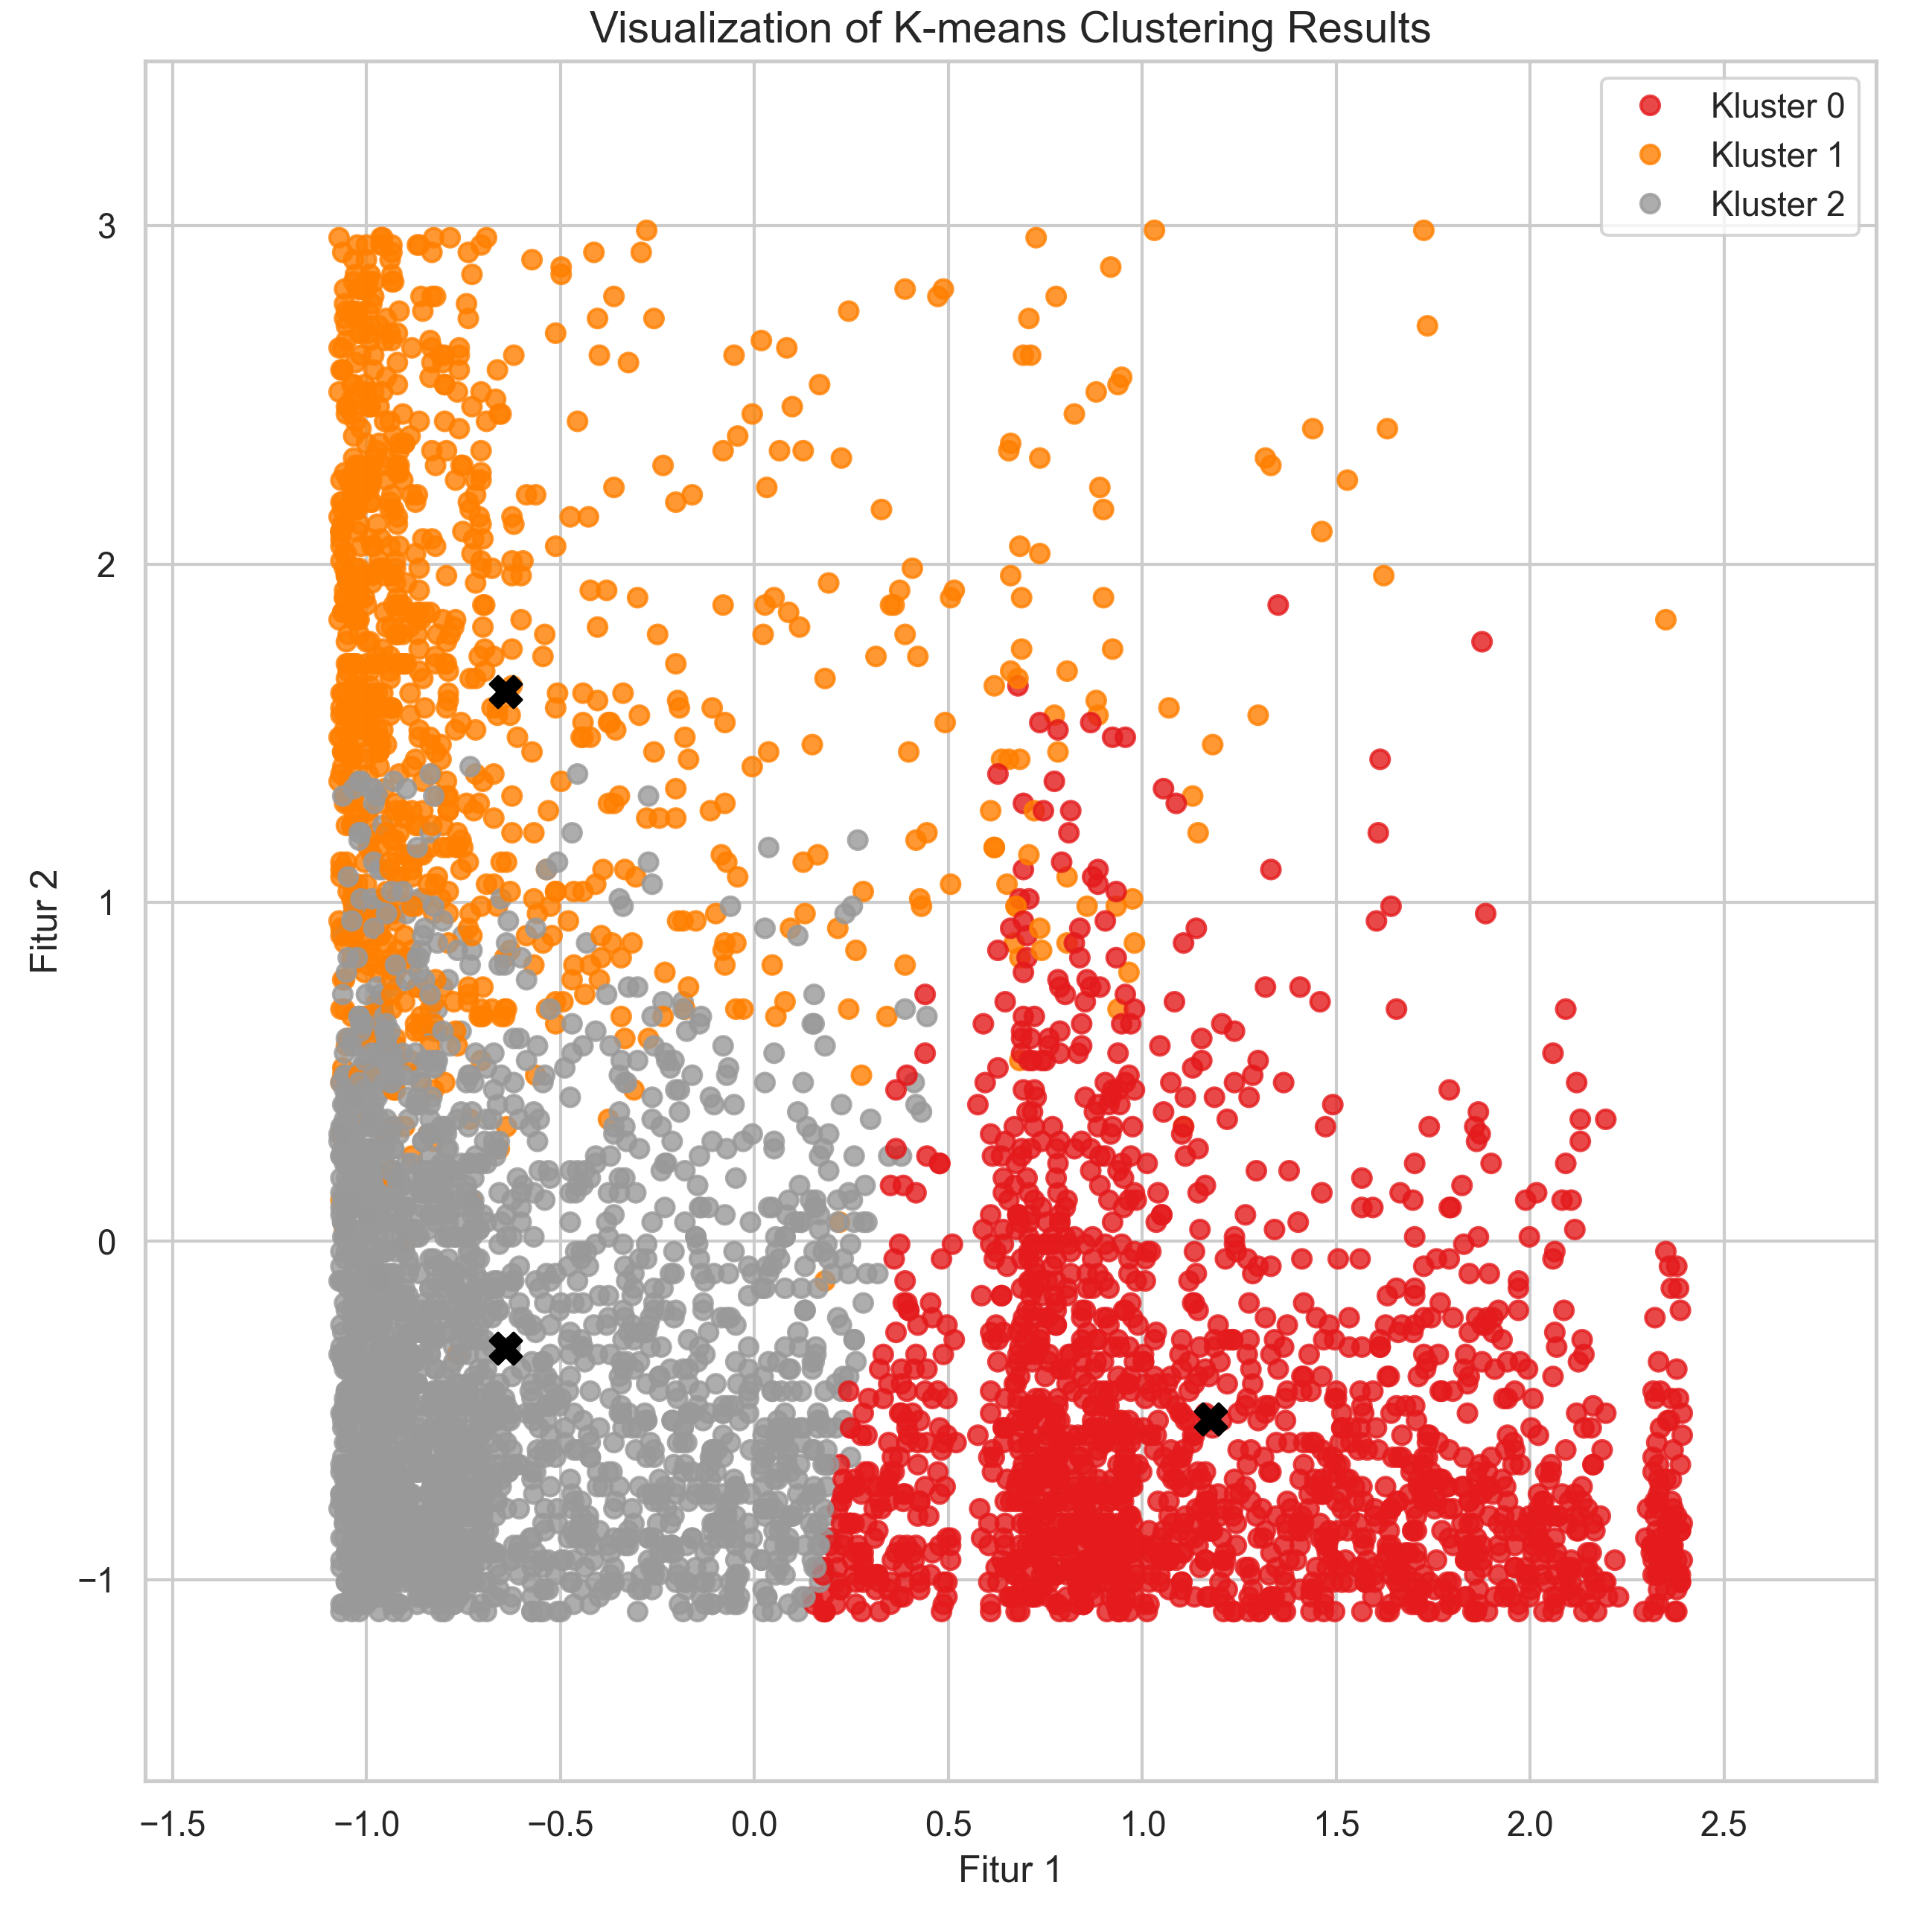
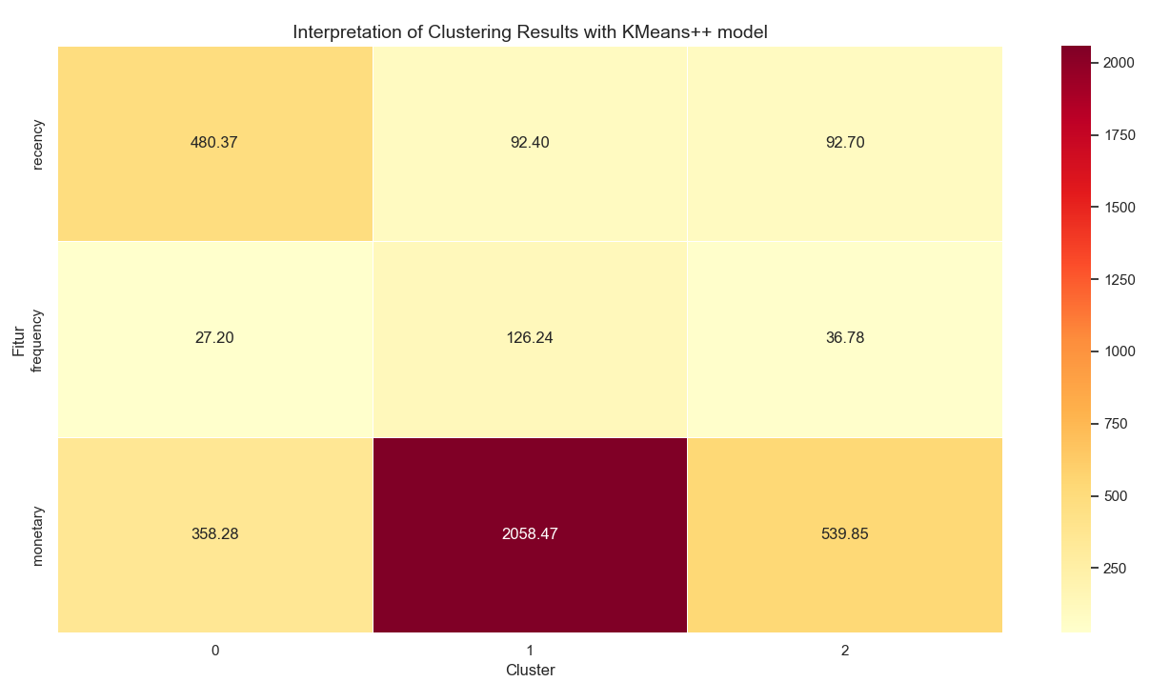
KMEANS CLUSTERING RESULT

Slide 24
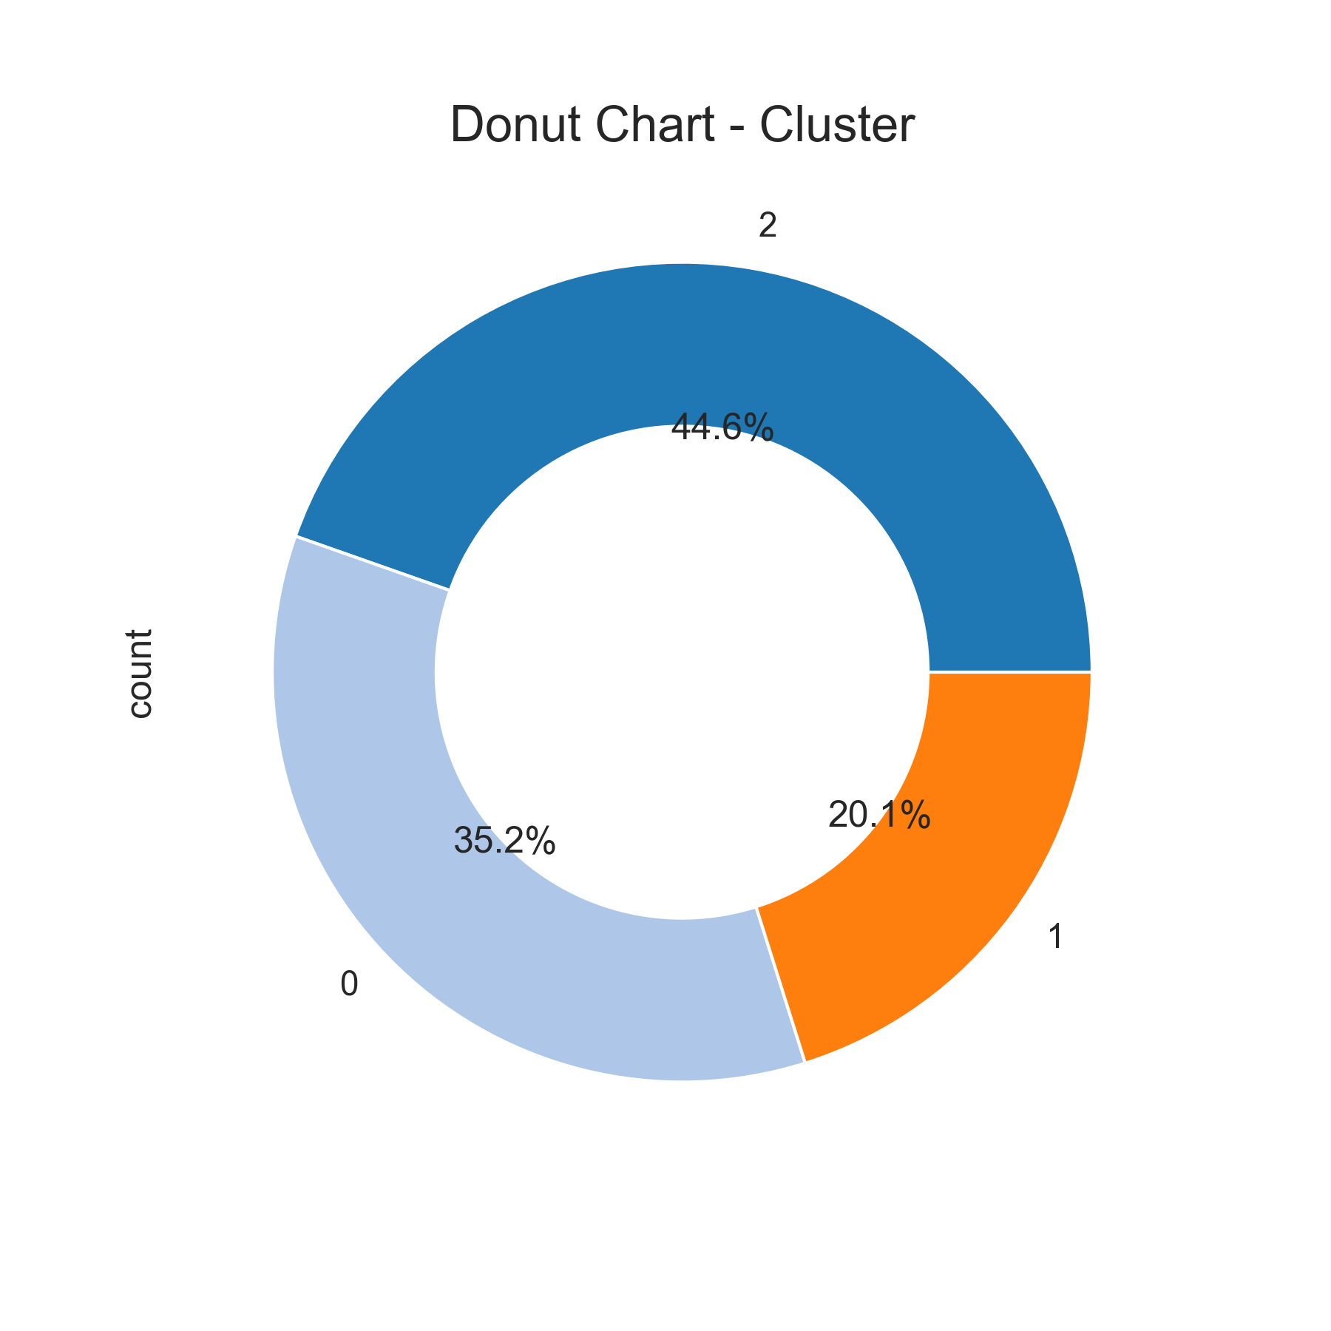
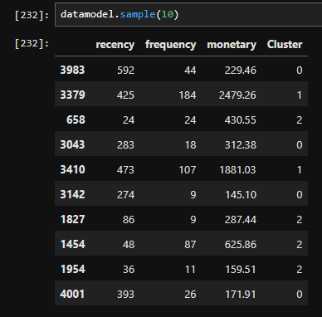
PROPORTION AND APPLICATION OF K-MEANS CLUSTERING ON CUSTOMER DATA

Slide 25
LET’S REVIEW WHAT HAS BEEN DISCUSSED
Market Expansion
Determine strategies for market expansion so that sales do not depend on one region
Trend Transaction
Using Trend chart as a Reference for Market Expansion Strategy
Customer Segmentation
Using RFM models and K-means clustering as a basis for customer segmentation
Marketing campaigns
Combining trend charts and customer segmentation as consideration for campaigns that will be used
Company goals
Combining various methods of analysis results to achieve the target that the company wants

Slide 26
THANKS!
Any questions?
You can find me at
bayunugrozzz@gmail.com

Slide 27

TEAM PRESENTATION
Bayu Setyo Aji Nugroho DATA ANALYST
“Hidup bukan hanya tentang hasil tapi tetaplah percaya akan PROSES untuk mencapai hasil tersebut”

